Slide 1

V8 JavaScript Engine
V8 engine is a core component of the Node.js

Slide 2
Why Node
Open source cross platform JavaScript runtime environment that can execute code outside browser. Allows developers to build server-side and network applications with JavaScript.
Great for web apps and mobile apps that use backend services.
It's Asynchronous so it works really well for - real time data intensive applications
Easy to get started with
JavaScript coding - more consistent frontend and backend for cleaner code.
Largest Ecosystem of open source libraries - focus on core of your application with faster build times. Many modules that saves you time writing code.
Can run as a standalone process on your machine
Can connect to databases, web servers and application servers.
Allows JavaScript to do what C++ can do using the Google V8 Engine
Single threaded asynchronous JavaScript runtime - executing code on the same thread. No waiting and can do more than one thing at a time. Non Blocking Input Output. Single threaded, asynchronous programming, which is very memory efficient
Can generate page content
Create, open, read write, delete files on your server
Node has js file extension.
Not a Programming language - it’s a runtime environment.
Both the browser and Node.js use JavaScript as their programming language.

Slide 3



JavaScript in the browser
Chrome sends JavaScript to V8 engine and gets the results returned.
Chrome send C++ bindings.
Allows Browser to interact with DOM
Chrome methods in JavaScript sent to V8 which runs in C++ and returns the functionality.

Slide 4
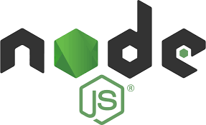
JavaScript with Node
Node sends JavaScript to V8 engine and gets the results returned.
Node sends methods to V8 which returns the results.

Slide 5

History
Prior to 2009 JavaScript only executed in browsers.
2009
Node.js is created C++ running the same V8 engine
First form of npm is created
V8 - Released with Chrome in 2008

Slide 6
Node in terminal vs browser
node - command in terminal
Write JavaScript code
Document object DOM - only in browser - we have a window to work with.
Node does not have a document
Node has variable called global
Browser does not have global

Slide 7
Non-blocking Asynchronous
Response
Node is highly scalable and fast because its Non-blocking Asynchronous in nature.
Does not need to wait for the response before moving on to the next request
Single thread handles all requests
Event Queue - when the response is ready then it is executed.
Single
Thread
Request
#1
Request
#2
Request
#3

Slide 8

Blocking or Synchronous
Waiting until the response is ready and does not take another request until the first request is complete.
Request
#1
Single
Thread
Response
Request
#2
Request
#3

Slide 9
Speed difference
Request
10 Seconds
Request
10 Seconds
Request
10 Seconds
Requests still take the same time to process - there is an advantage as the following requests can be made while waiting.
Not for CPU intensive applications
10 Seconds
Request
10 Seconds
Request
10 Seconds
Request

Slide 10
Variables
Declare variables at the top of their scope.
Scope is the block of code
Variables in JavaScript can be defined using either the var, let or const keywords.
Before you use a variable you need to declare the variable.
var varName = ‘value of the variable’;
RULES
JavaScript is Case Sensitive
camelCase when writing JavaScript variables
Can’t use reserved words
No Spaces in variable name
Can’t start with digit only letter, $, or _
var - only option before ES6 version
Variables can be re-declared and updated as needed within the same scope and you won’t get an error.
Scope - variables are only available within the scope. block is chunk of code bounded by {}. Local scope indicated with {} vs global scope outside the {}
var x; // declare the variable
console.log(x); //will be undefined
var varName = 'value of the variable';
console.log(varName);
let val1 = "test value with Double Quotes";
val1 = "new value of Val1"; //variables can change in value
console.log(val1);
const val2 = "Another value";
val2 = "new Value won't work";
console.log(val3); //won’t work!!! Needs to be declared first
let val3 = "test try before declaring";

Slide 11
Variables
Problem with var is that errors and bugs can occur. If you can re-assign value to it, it might happen unintentionally.
Let and const fix this! They are block scoped.
You will get errors in the code that will stop the execution of it if you change the var to let. let is not initialized whereas var is initialized as undefined.
let can be updated but not re-declared within its scope. If defined in different scope there will be no error.
const declarations are block scoped as well.
const cannot be updated or re-declared
var test = "Hello World";
var test = "Hello World Again";
console.log(test);
test = "New one";
console.log(test);
console.log(test1); //undefined
var test1 = "Hello";
console.log(test1); //Hello
if (5 > 3) {
var test1 = "World";
}
console.log(test1); //World
let test = "Hello World";
//let test = "Hello World Again"; //Error
console.log(test);
test = "New one";
console.log(test);
//console.log(test1); //Error
let test1 = "Hello";
console.log(test1); //Hello
//Problem
if (5 > 3) {
let test1 = "World";
}
console.log(test1); //Hello

Slide 12
Data Types
Explore different data types, strings, numbers, booleans. Dynamic data types and how JavaScript converts types. Simple concatenation of variables
JavaScript is a loosely typed or a dynamic language. Variables in JavaScript are not directly associated with any particular value type, and any variable can be assigned (and re-assigned) values of all types
The typeof operator returns a string indicating the type of the unevaluated operand.
let num = 500; /// Number
let str = 'Hello World'; //string single quotes
let str2 = "Hello World"; // string double quotes
let boo = true; //Boolean
let noValue = null; // Null set a variable to no value
let noSetValue = undefined; // used for variables that have not been defined
console.log(num);
console.log(typeof num);
num = "500";
console.log(num);
console.log(typeof num);
var foo = 42; // foo is now a number
foo = 'bar'; // foo is now a string
foo = true; // foo is now a boolean

Slide 13
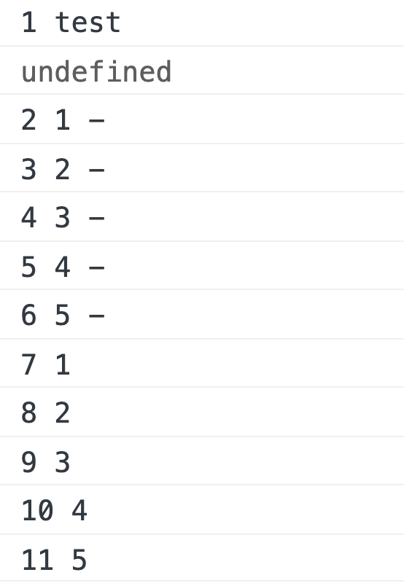
Stack vs Queue
JS Stack
console.log(counter+' '+'test');
Callback Queue
setTimeout(callback,0,`${el}
setTimeout(callback,1000,el);
const arr = [1,2,3,4,5];
let counter = 0;
function aFun(myArr,callback){
myArr.forEach((el)=>{
setTimeout(callback,1000,el);
})
myArr.forEach((el)=>{
setTimeout(callback,0,`${el} -`);
})
}
aFun(arr,(val)=>{
counter++;
console.log(counter+' '+val);
})
counter++;
console.log(counter+' '+'test');
Added to Stack

